Slide 1
CS491/691: Introduction to Aerial Robotics
Real-Time Simultaneous Localization and Mapping with a Single Camera Summary
Marcus Casey, Anurag Kulkarni

Slide 2
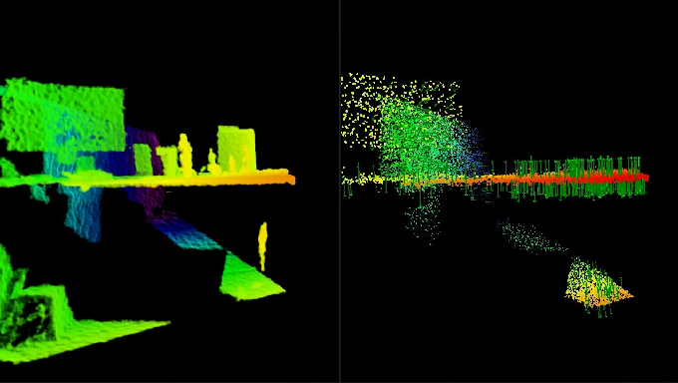

Introduction
New applications have been developed and researched for camera-based localization and mapping, which has now allowed for new real-time processing to be crossed.
With real time processing now a reality, motion estimation for moving cameras are now able to be utilized for immediate usage in different interactive and modern scenarios.
Use an image to explain the motivation and the challenges
CS491/691 Introduction to Aerial Robotics, Marcus Casey, Anurag Kulkarni, Instructor: Dr. Kostas Alexis

Slide 3
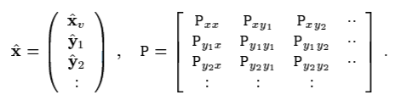
Repeatable Localisation
In reference to structure in motion research, in regards to computer vision, technology has finally reach a point in which fully automated reconstructions of trajectory of video cameras moving through a thought to be unknown scene, is now becoming routine.
However, successful and other approaches today have all been created and modified as off-line algorithms and required batches, which means that there was simultaneous processing of all images that were then acquired in the sequence.
Overview the solution in the form of a block diagram
CS491/691 Introduction to Aerial Robotics, Marcus Casey, Anurag Kulkarni, Instructor: Dr. Kostas Alexis

Slide 4
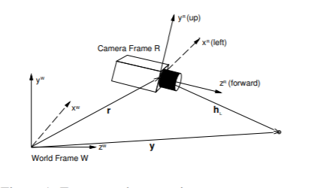
Repeatable Localization
Long chains also can be considered a frame to frame motion solution that can be now be stitched together that can create an estimate of complete camera trajectories
Additionally a full 3D map of all features observed can be created which then allows for the entire solution of the motion problem to be refined. Batch processing will provide the most accurate solution to any estimation problem with off-line operation.
Overview the solution in the form of a block diagram
CS491/691 Introduction to Aerial Robotics, Marcus Casey, Anurag Kulkarni, Instructor: Dr. Kostas Alexis

Slide 5


Motion Model For Smooth Moving Camera
In order to ensure that the filtering result in a true quaternion, normalization must be performed at each step of the EKF. Normalization is then accompanied by a corresponding Jacobian calculation affecting the covariance matrix.
Although there are a variety of candidate measurements for camera movement, it is critical that the ones with high innovation covariance be chosen.
CS491/691 Introduction to Aerial Robotics, Marcus Casey, Anurag Kulkarni, Instructor: Dr. Kostas Alexis

Slide 6
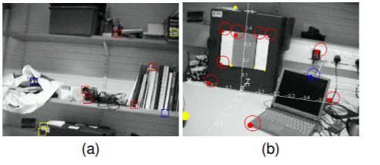
Motion Model For Smooth Moving Camera
Due to their projective nature, camera measurements provide a measurement based on camera position and a certain ‘feature’, however, depth issues may arise. 3D depths for features are difficult to measure with single measurements
When the ratio of the standard deviation of depth to depth estimate drops below a certain threshold, the distribution is safely approximated as Gaussian and the feature initialised as a point into the map.
Overview the solution in the form of a block diagram
CS491/691 Introduction to Aerial Robotics Marcus Casey, Anurag Kulkarni, Instructor: Dr. Kostas Alexis

Slide 7
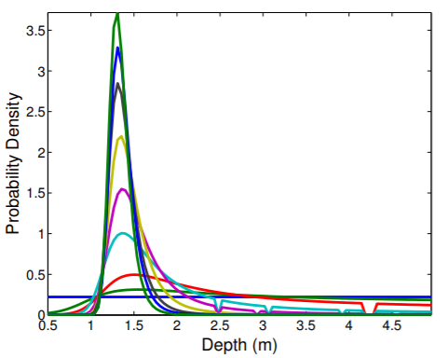
Visual Feature Measurements
In order to choose the features in the map, feature visibility is calculated based on the relative position of the camera. That is, the feature must be predicted to fall under the plane.
That is, if the measurements taken on an overall basis, the ones most frequently detected or matched will be the ones that will stay in the map.
Overview the solution in the form of a block diagram
CS491/691 Introduction to Aerial Robotics, Marcus Casey, Anurag Kulkarni, Instructor: Dr. Kostas Alexis

Slide 8
Conclusions and Remarks
One of the basic characteristic of a full-covariance EKF SLAM is that the computational complexity is of order N^2 where n is the number of features in the map.
The Kalman filter update time begins to increase exponentially as the number of features approaches 100.
A top-down Bayesian approach to sequential Simultaneous Localisation and Mapping or Structure from Motion which takes account of the extra sources of information that get missed.
Lastly we are convinced of the benefits of active search based on information content, but there is much to be done to apply information theory rigorously in this domain
CS491/691 Introduction to Aerial Robotics, Marcus Casey, Anurag Kulkarni, Instructor: Dr. Kostas Alexis

